Slide 1



EXPENSES TRACKER USING AL AND ML
PRESENTED BY
SANTHANALAKSHMI M
CB.AI.P2DSC25028
1

Slide 2
Problem Statement/Background
  Managing money has become more complicated today because people rely heavily on digital payments, subscriptions, online shopping, and multiple small transactions happening every day.
  Most people want to control their finances, but they are too busy to manually note expenses or analyze monthly spending patterns.
  Traditional finance apps only show past spending, but they lack future predictions like upcoming expenses, budget alerts, and spending trend insights.
  Our project comes from the goal of making financial tracking simple, automatic, and smart. We will achieve this through data analytics, clear visualizations, and machine learning.
2

Slide 3
Objective
smart finance system
01
predict next-month expenses
02
user-friendly dashboard
03
AI chatbot assistant
04
Automated analysis of user transactions creates useful financial insights.
The system predicts next-month expenses using machine learning techniques.
Clear visualization shows income trends, spending patterns, and category-wise expenses.
Personalized financial help from an integrated AI chatbot improves decision-making.
Where is my money going, and how can I manage it better?
3

Slide 4
Literature Review
Manual Expense Tracking
  Users enter expenses manually in notebooks, Excel sheets, or simple mobile apps.
  No automation, no categorization based on SMS/email, and no forecasting.
No Predictive Analytics
  Traditional systems only display past expenses and lack any ability to forecast future spending, predict overspending, assess financial risk, or provide personalized financial recommendations.
Lack of Intelligent Predictive Models
  Existing systems lack intelligent ML/DL predictive models, so they fail to detect key financial patterns like monthly trends, seasonal peaks, user-specific habits, and natural spending cycles.
No Personalized Financial or Insurance Recommendations
  Existing systems lack intelligent ML/DL predictive models, so they fail to detect key financial patterns like monthly trends, seasonal peaks, user-specific habits, and natural spending cycles.

Slide 5
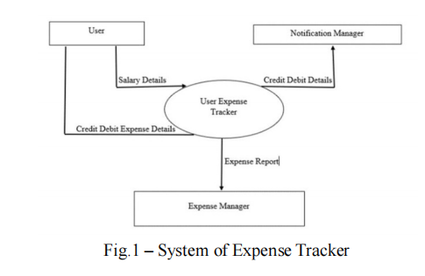


Proposed System
User Interaction & Data Input:
  Users provide salary and transaction details
  Data is collected and prepares them for ML analysis.
Machine Learning-Based Prediction:
  ML models such as Random Forest,and SVR are used to learn user spending behavior.
  The model predicts next month’s total expenses, category-wise spending, and budget overspending based on the user’s spending habits.
Personalized Spending Insights:
  Provides personalized spending insights through a centralized dashboard that visualizes savings, borrowings, lending details, saving goals, and category-wise expenses and income.
4

Slide 6
Methodology
  Data Collection: Gather user transactions, external API data, and insurance info for comprehensive financial analysis.
  Data Preprocessing: Clean data, handle missing values, normalize, and engineer features like monthly aggregation and income/expense flags.
  Machine Learning: Train models (SVR & Random Forest) to predict future expenses; Random Forest gives high accuracy.
  Dashboard & AI: Visualize income vs. expenses, category-wise spending, predicted costs; AI chatbot provides budgeting and financial recommendations.
5

Slide 7
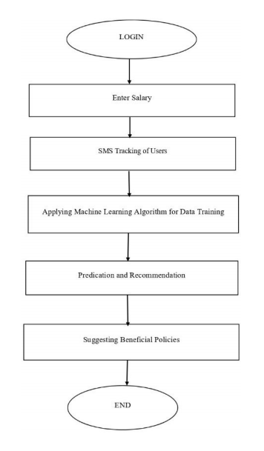
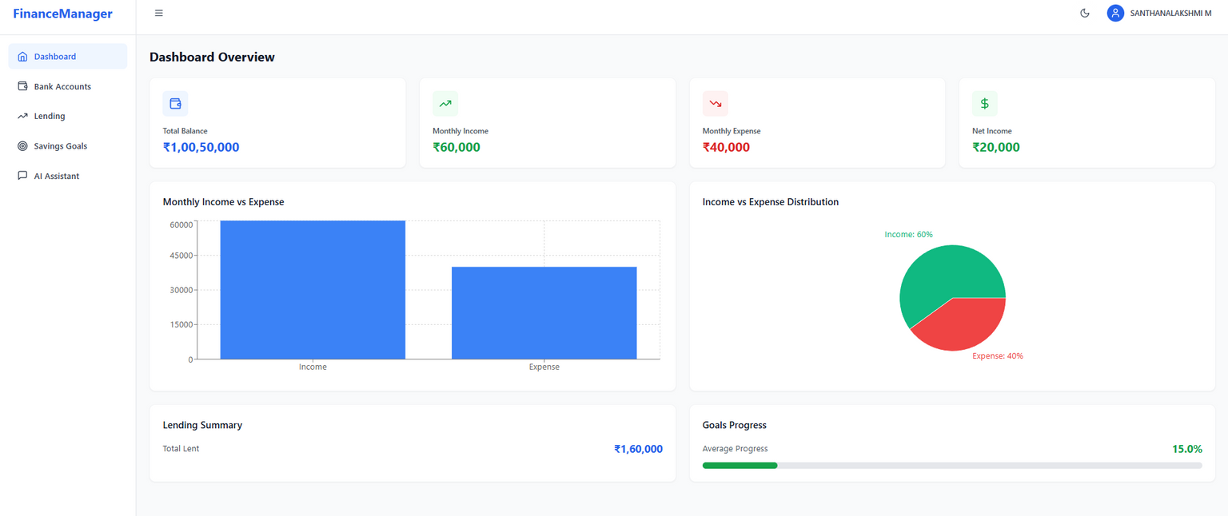
Workflow
6

Slide 8
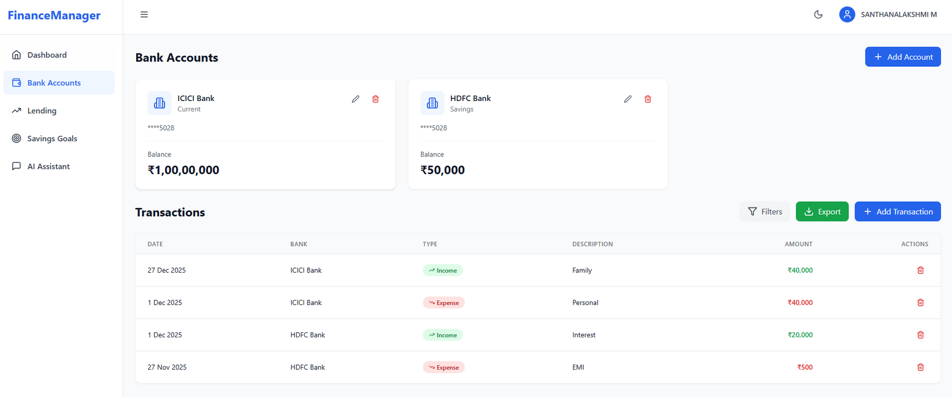
While Mint and YNAB do support multiple accounts, they are region-specific and focus mainly on budgeting or manual imports. Our system handles multiple bank accounts in one unified dashboard and adds intelligent ML predictions, spending insights,lending and borrowing details and goal tracking these features not provided together by existing systems.
7

Slide 9
Results
Model Performance:
  Random Forest: MAE = 82.89, RMSE = 87.05 → high accuracy, excellent for structured financial data.
  SVR: MAE = 96.92, RMSE = 98.25 → moderate accuracy, good for general trend prediction.
Predicted vs. Actual Expenses:
  System reliably forecasts next-month spending based on historical data.
  Visual comparison charts show close alignment between predicted and actual expenses.
Visual Insights:
  Category-wise spending (Food, Bills, Entertainment, etc.)
  Monthly income vs. expenses trends
User Benefits:
  Helps identify overspending categories and potential savings opportunities.
8

Slide 10
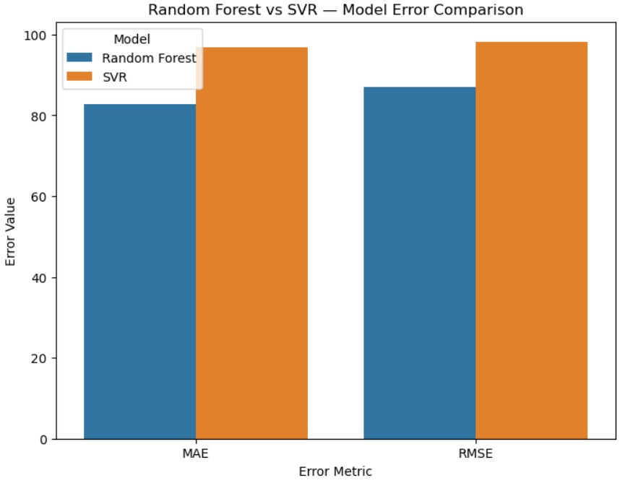
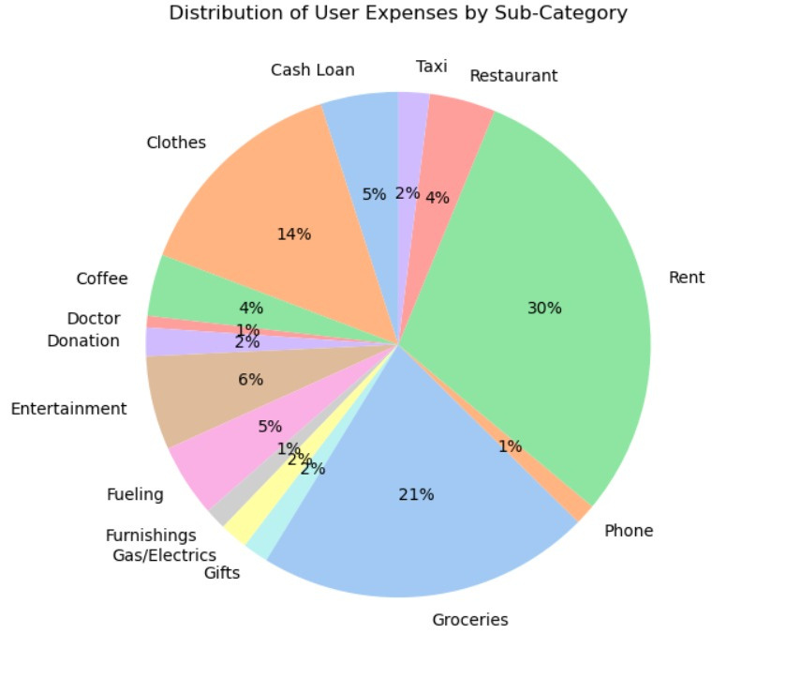
Results
9

Slide 11
Novelty
  The system allows users to link and monitor multiple bank accounts within a single platform, offering a consolidated view of all transactions in one place something most basic expense trackers lack.
  Beyond regular expense tracking, the platform uniquely integrates lending/borrowing records and personalized savings goals into a unified dashboard, enabling complete financial visibility.
  The system implements ML models to accurately forecast upcoming month expenses based on historical spending patterns, giving users proactive financial insights.
  Using predicted expenditure and income trends, the system provides personalized recommendations to help users cut unnecessary spending and increase savings over time.
10

Slide 12
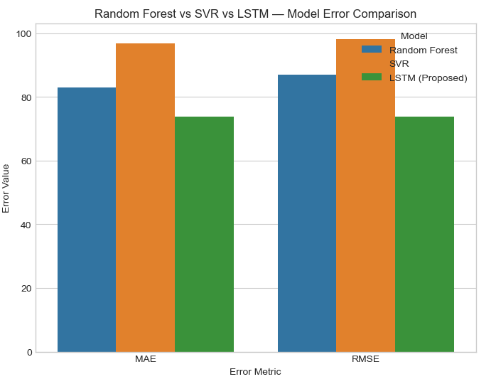
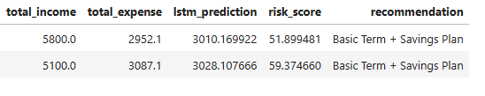
Result
Financial Guidance: The system uses LSTM-predicted expenses and risk scoring to provide personalized, proactive recommendations for budgeting, savings, and insurance planning.
The LSTM model provides most reliable highly accurate and stable time-series predictions of user expenses, capturing temporal patterns to enable reliable forecasting, personalized budget insights, and proactive financial recommendations
11

Slide 13
Discussion and Analysis
  Strengths: Real-time predictions, dynamic dashboard, personalized insurance recommendations, accurate ML models.
  Limitations: Small test user base, may need tuning for diverse financial behaviors, relies on accurate user data
  Assumptions: Users consistently enter transactions; income and expense patterns remain relatively stable month-to-month.
  Overall Insight: System effectively forecasts expenses and provides actionable financial guidance, but performance depends on data quality and user consistency.
12

Slide 14
Application & Relevance
  The system enables users to automatically track expenses, detect spending behavior, and plan monthly budgets using ML-driven forecasting bringing real-time financial discipline into everyday life.
  The system assists users in making smarter financial decisions by analyzing historical spending patterns and offering AI-driven recommendations that reduce overspending and improve budgeting habits.
  This can be extended into banking apps, e-wallets, or corporate expense management systems for automated financial monitoring.
  The project showcases practical application of machine learning, AI, and data preprocessing in solving real-world financial problems, making it relevant for research, fintech innovation, and industry adoption.
13

Slide 15
Conclusion
  Developed an AI/ML-based Expense Tracking System that forecasts monthly expenses and offers personalized insurance recommendations.
  Implemented thorough data preprocessing, feature engineering, and model evaluation, resulting in accurate predictions with Random Forest and SVR models.
  Designed a real-time interactive dashboard to show income vs. expenses, spending by category, and predicted financial trends.
  Integrated an AI chatbot that improves user experience by providing budgeting tips, financial insights, and insurance advice.
Overall, the system helps users take control of their finances, understand their spending habits, and make informed choices about savings and investments.
15

Slide 16
References
  [1]A. Gupta, R. Sharma, and N. Verma, “Spending Tracker: A Smart Approach to Track Daily Finances,” Turkish Journal of Mathematics Education, vol. 12, no. 6, pp. 123–134, Apr. 2021.
  [2]L. Liu, X. Zou, Y. Ma, and Z. Shao, “A Personal Expense Tracking System Based on OCR and Machine Learning,” Revista Iberoamericana de Inteligencia Artificial, vol. 22, no. 64, pp. 45–56, 2019.
  [3]K. Charan, A. Reddy, S. Kumar, and P. Mishra, “Financial Forecasting Using Machine Learning Algorithms,” International Journal of Engineering Research and Technology (IJERT), vol. 11, no. 5, pp. 789–795, May 2022.
  [4]T. S. Walia, R. S. Chimombe, G. Chandra, A. Noor, P. T. C. Chirag, and C. Sharma, “WealthGuardian—Smart Expense Management Using Machine Learning,” International Journal for Research in Applied Science and Engineering Technology (IJRASET), vol. 13, no. 5, pp. 441–447, May 2025, doi: 10.22214/ijraset.2025.70173.
  [5]A. Kumar and M. Sharma, “Financial Applications of Machine Learning: A Literature Review and Research Opportunities,” Expert Systems with Applications, vol. 219, art. no. 119640, Jun. 2023, doi: 10.1016/j.eswa.2023.119640.
16

Slide 17

17

